Slide 1
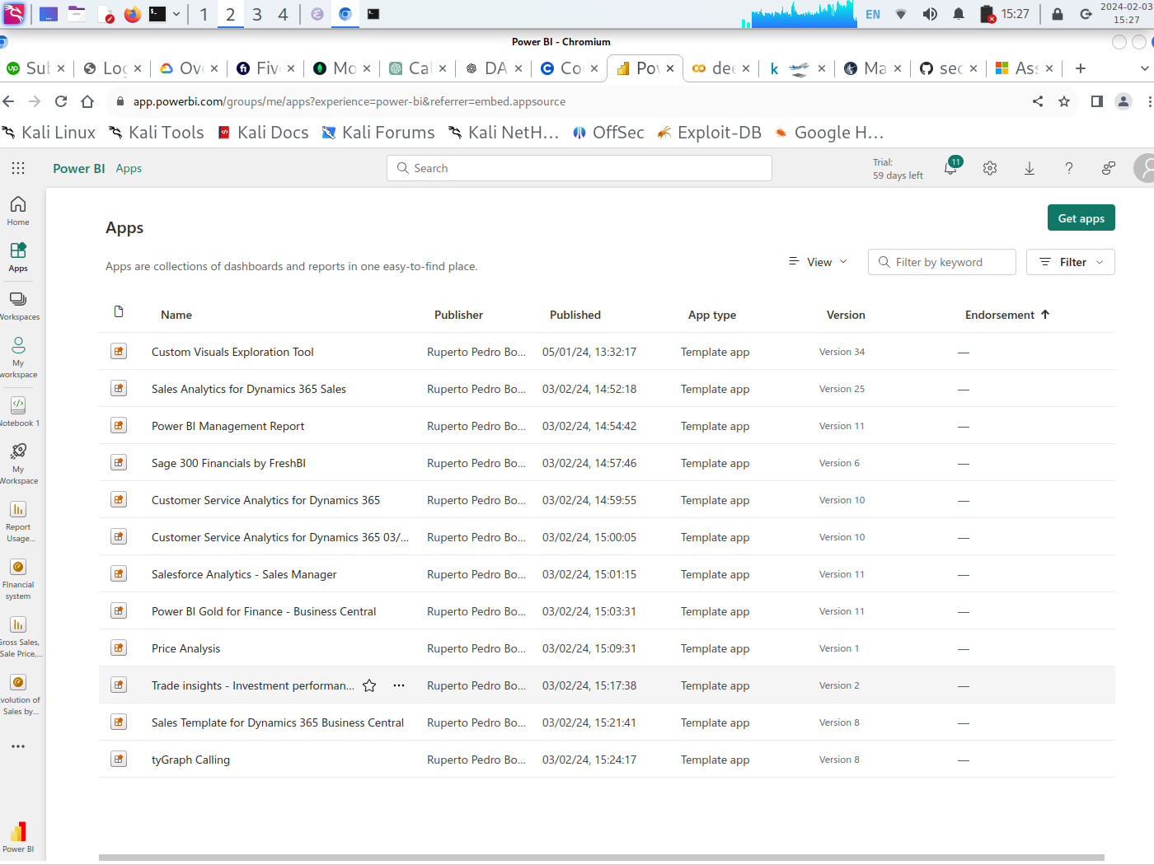
MY WORKSPACE

Slide 2
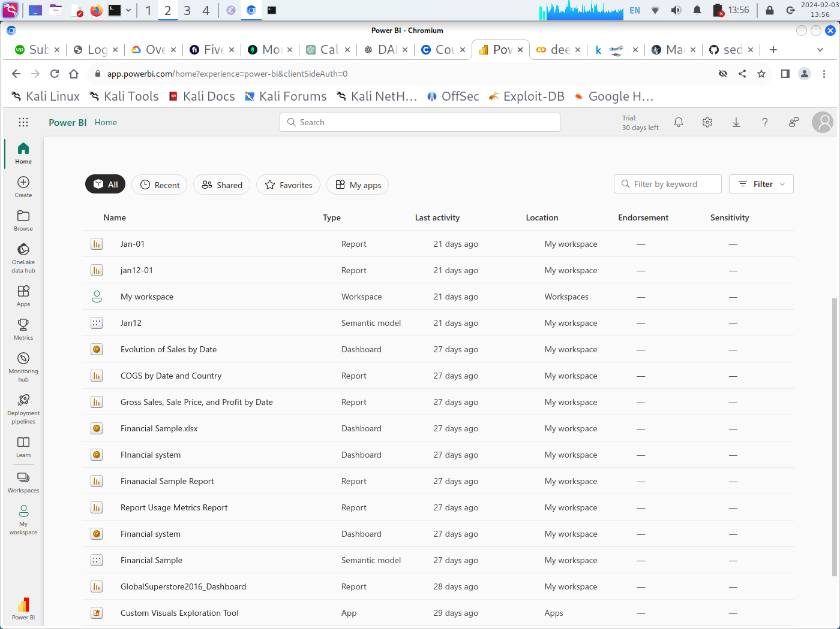
MY WORKSPACE HISTORY

Slide 3
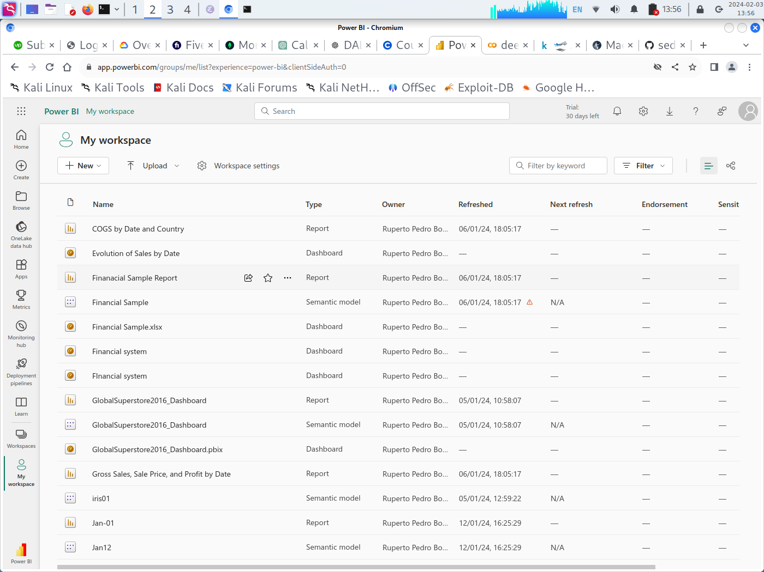

Slide 4
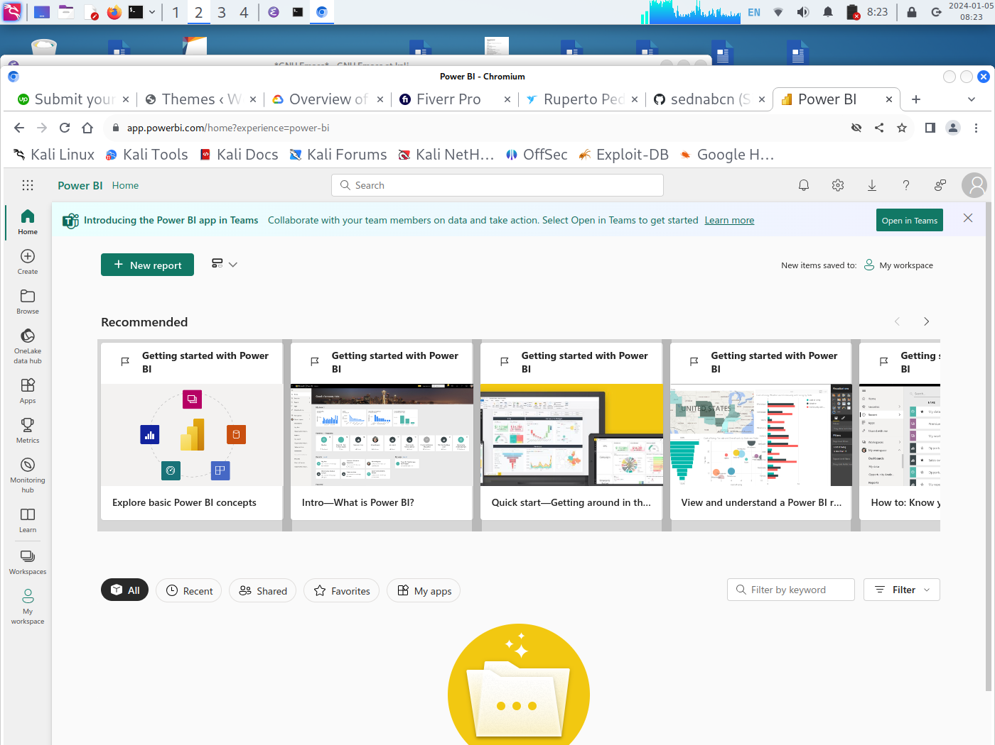
CREATE A NEW REPORT

Slide 5
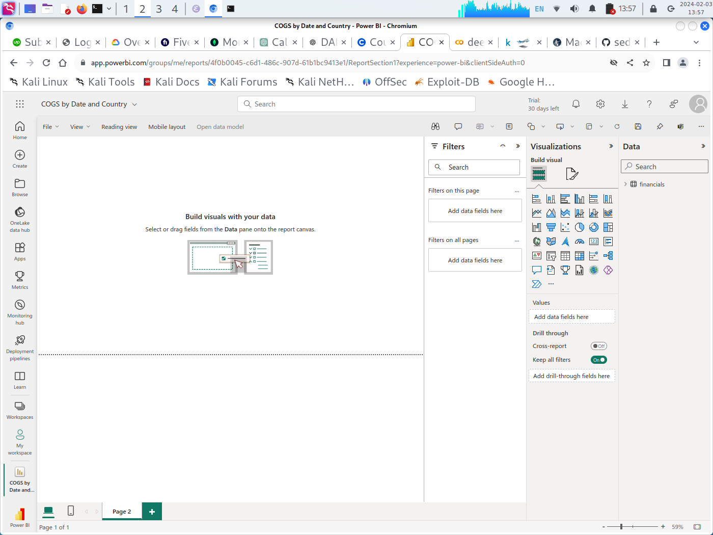
EXPLORATION OF DATA

Slide 6
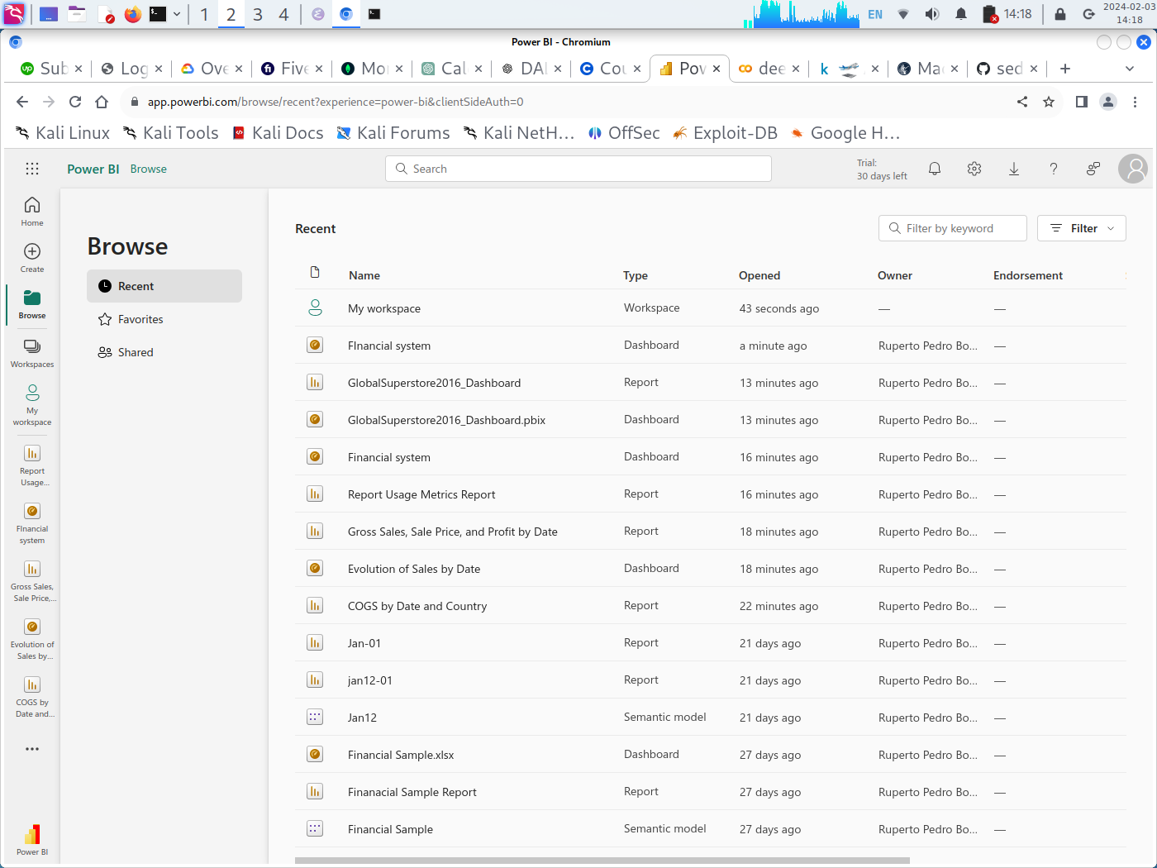
BROWSE A WORKSPACE , DASHBOARD OR REPORT

Slide 7
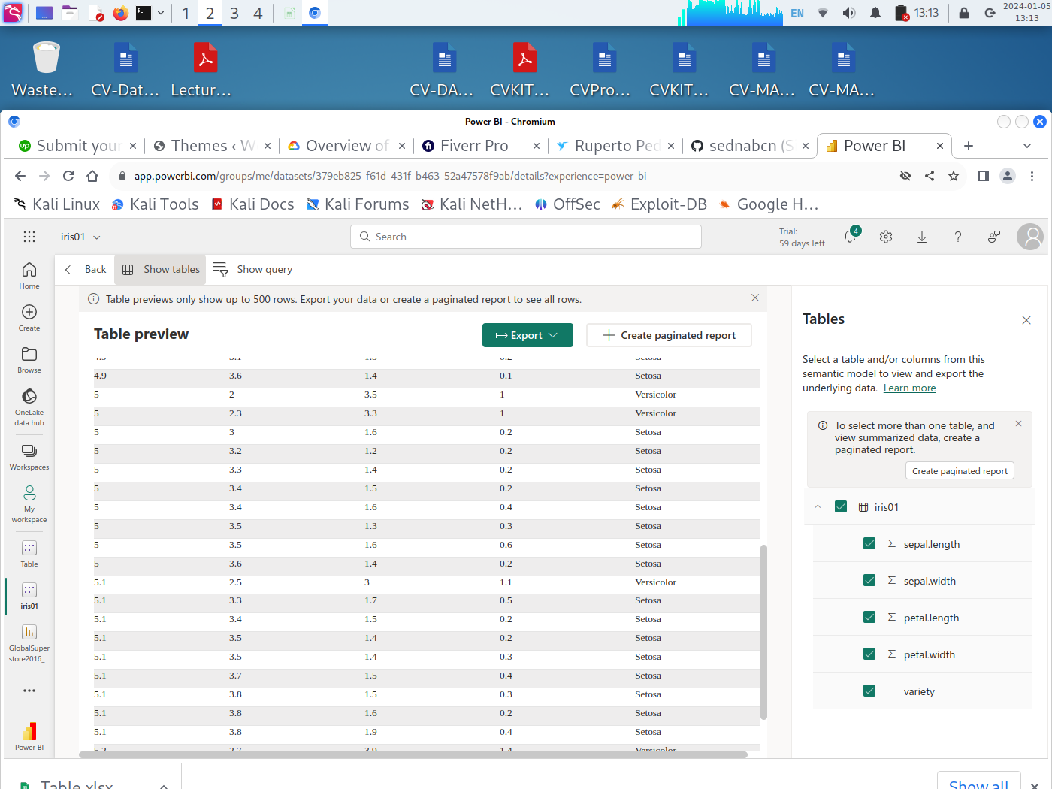
IRIS DATASET TABLE PREVIEW

Slide 8
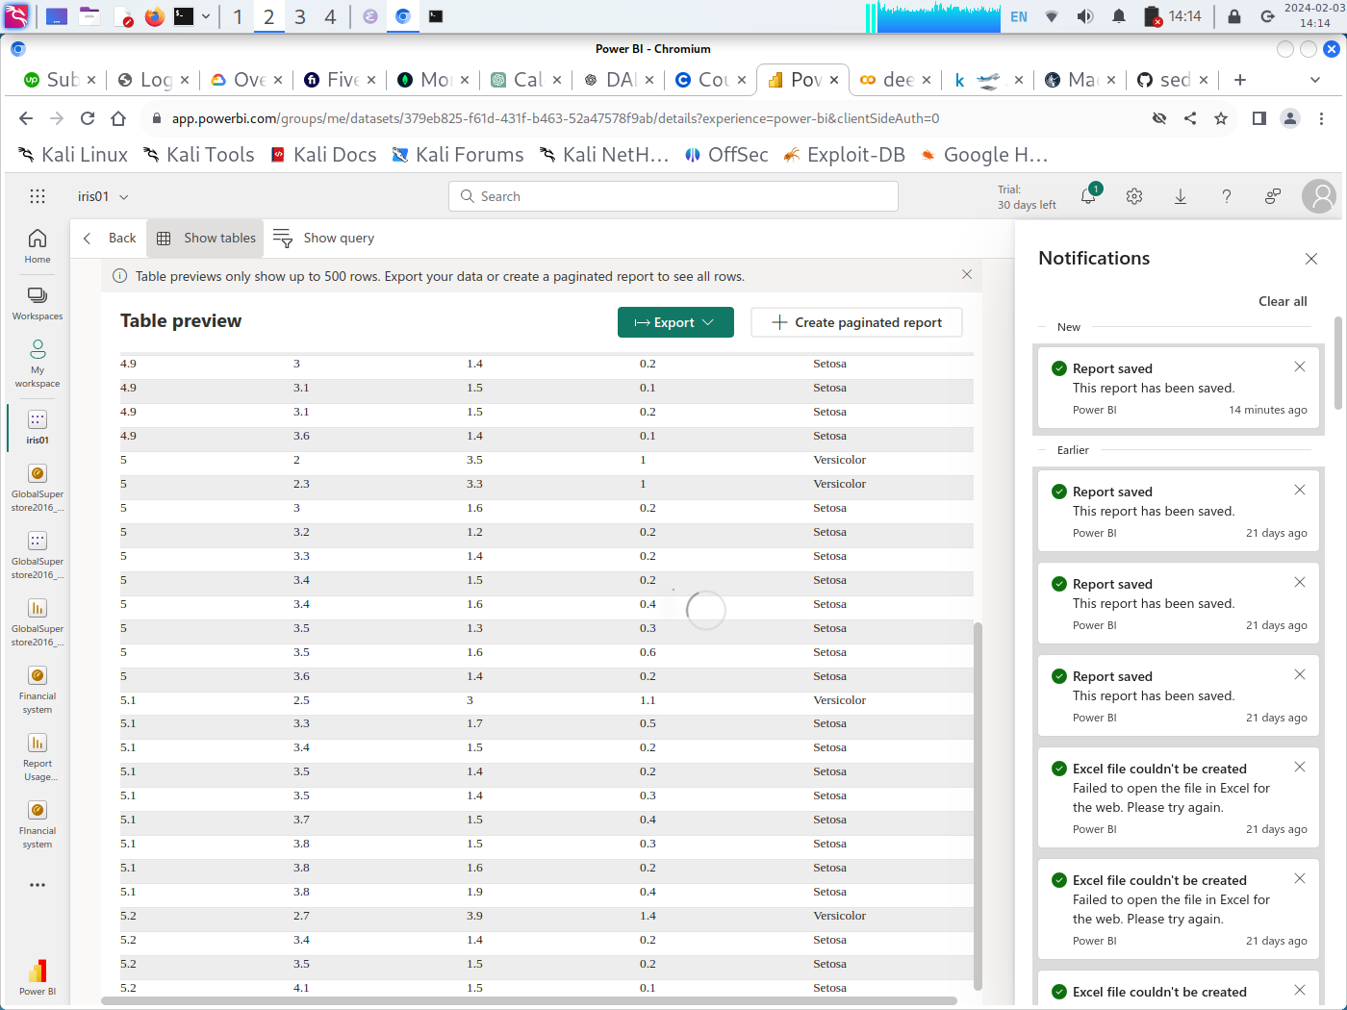
IRIS DATASET + NOTIFICATIONS ABOUT HISTORY OF WORKING

Slide 9
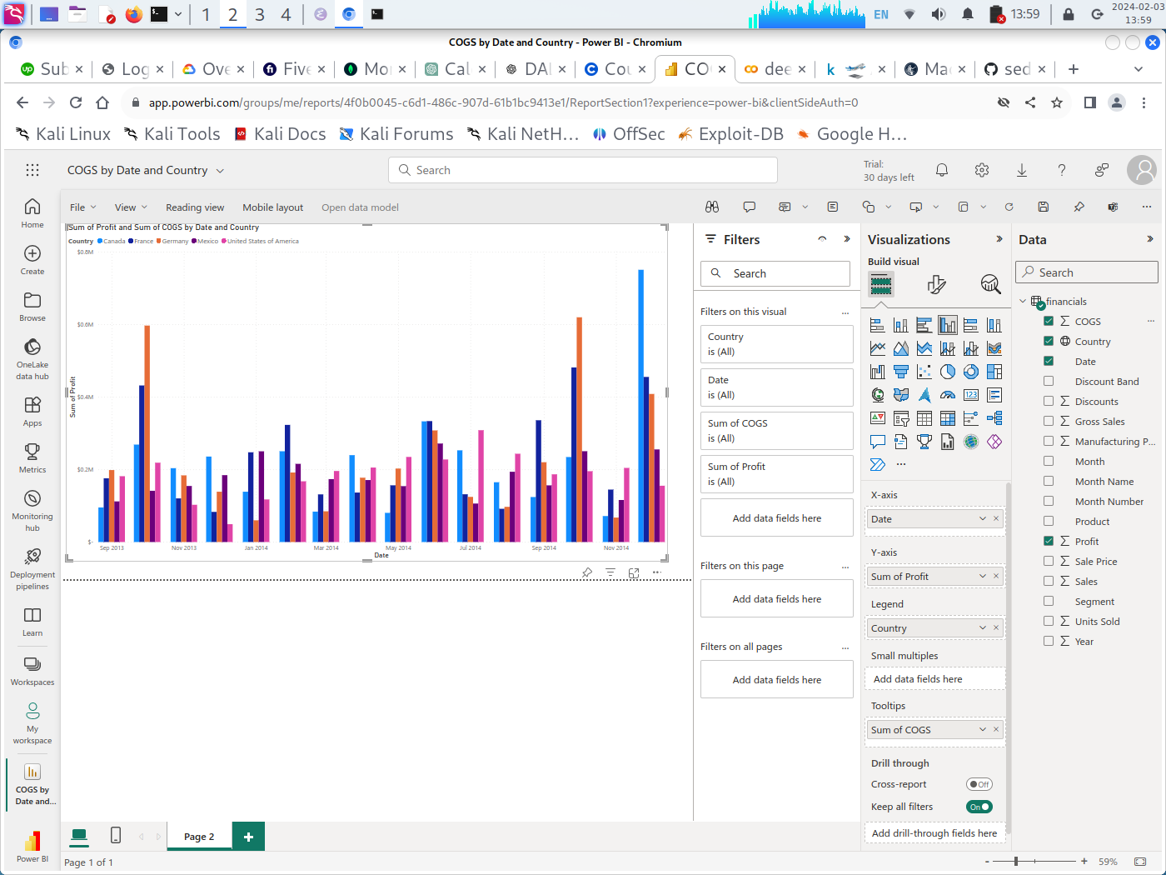
COGS by DATE AND COUNTRY DASHBOARD

Slide 10
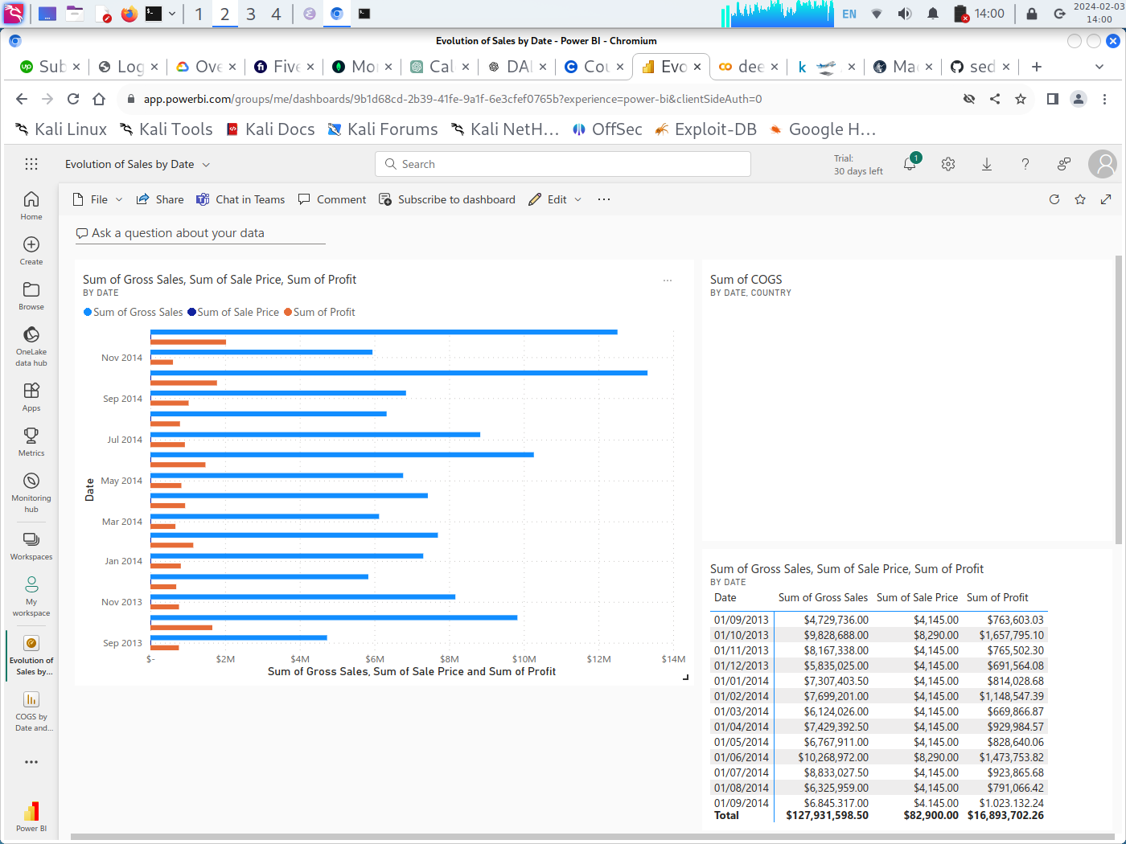
EVOLUTION OF THE SALES BY DATE

Slide 11
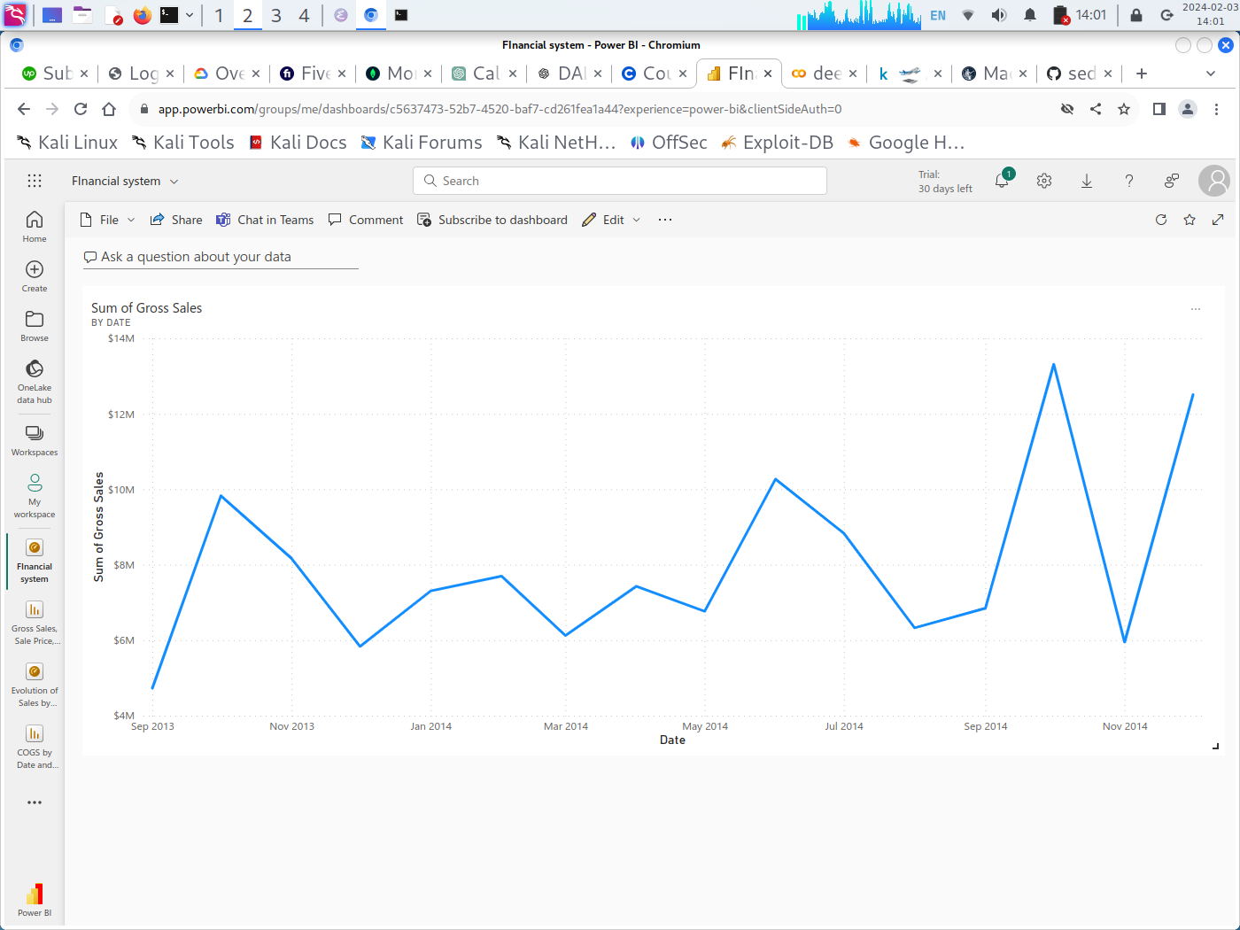
SCATTERPLOT OF THE SALES BY DATE

Slide 12
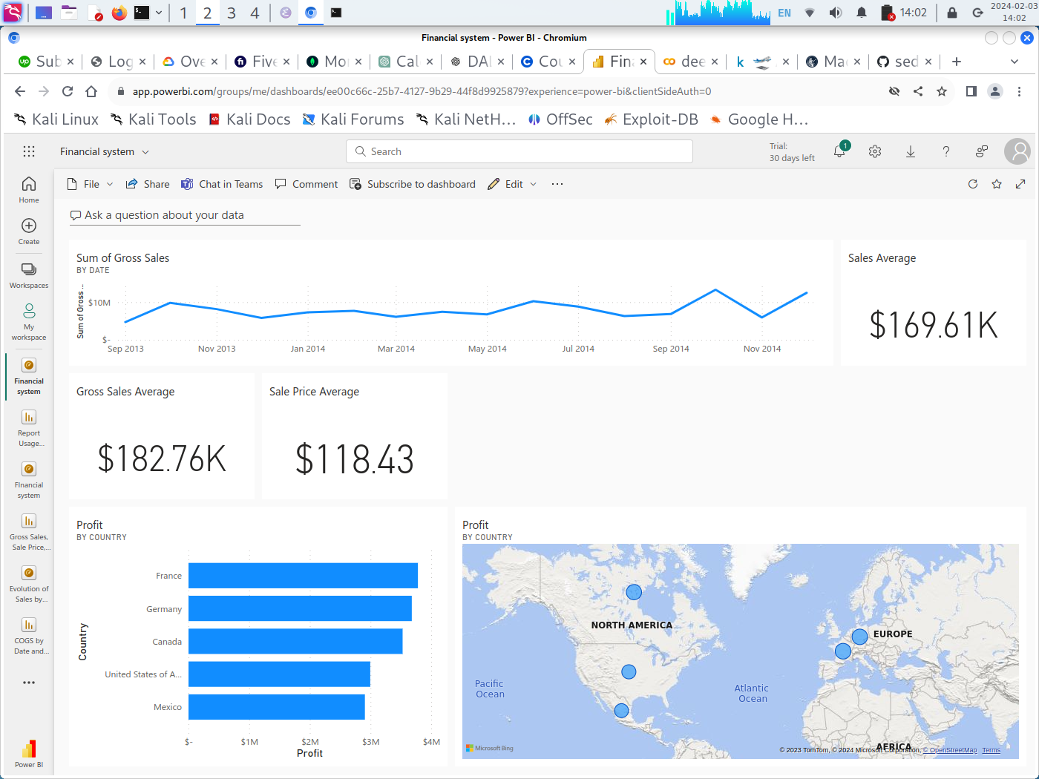
FINANCIAL SYSTEM DASHBOARD

Slide 13
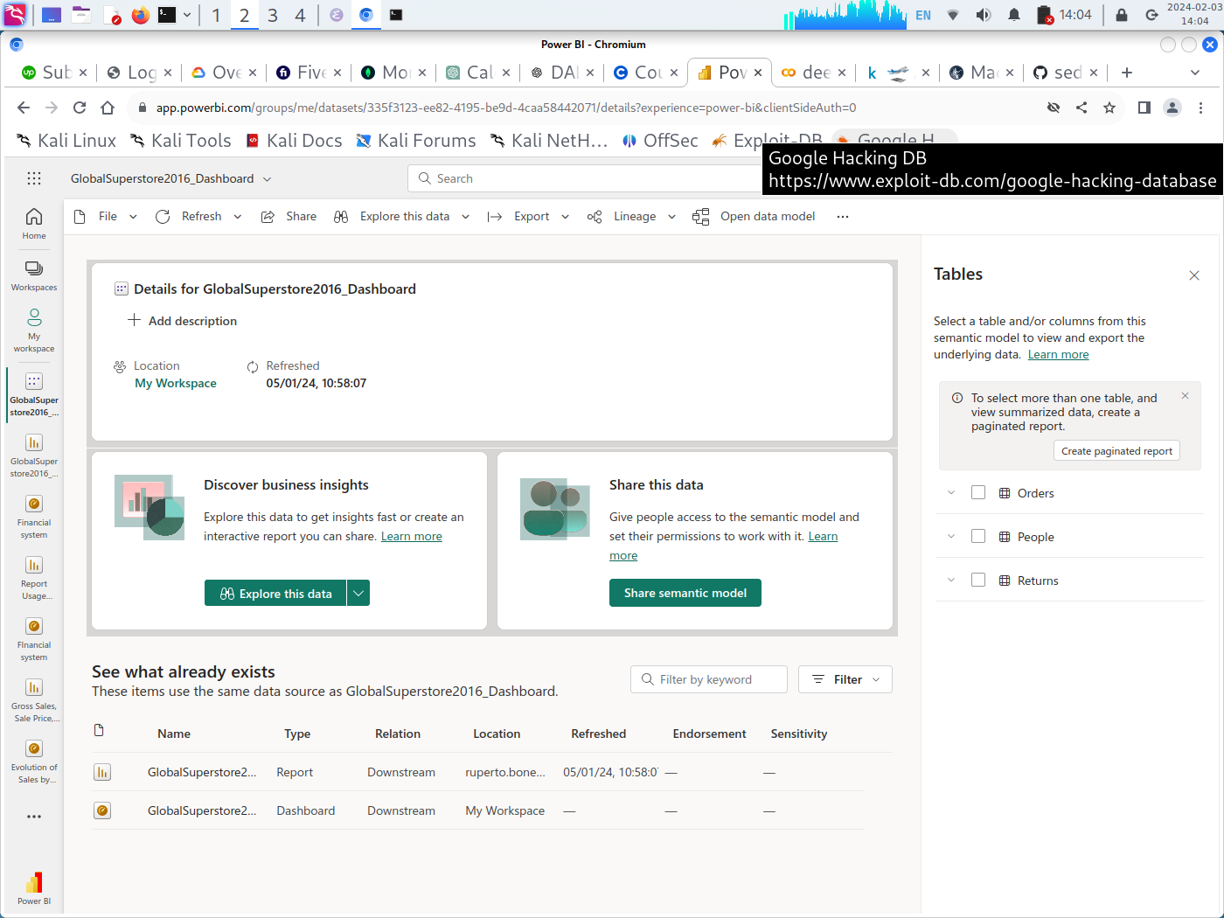
SELECTION OF EXPLORATION NEW DATA/
SEMANTIC MODEL

Slide 14
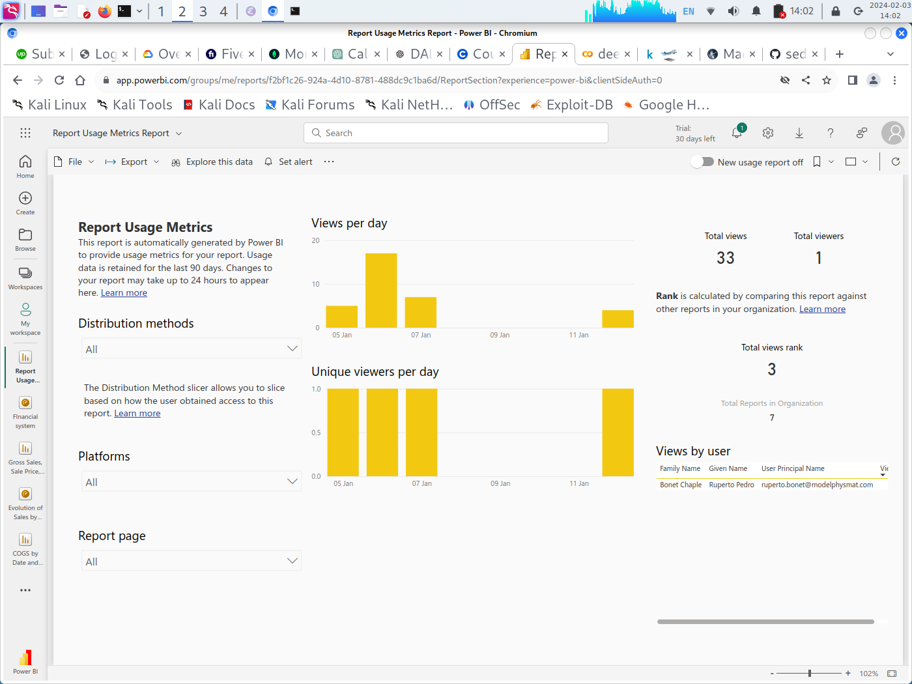
REPORTS USAGE METRICS

Slide 15
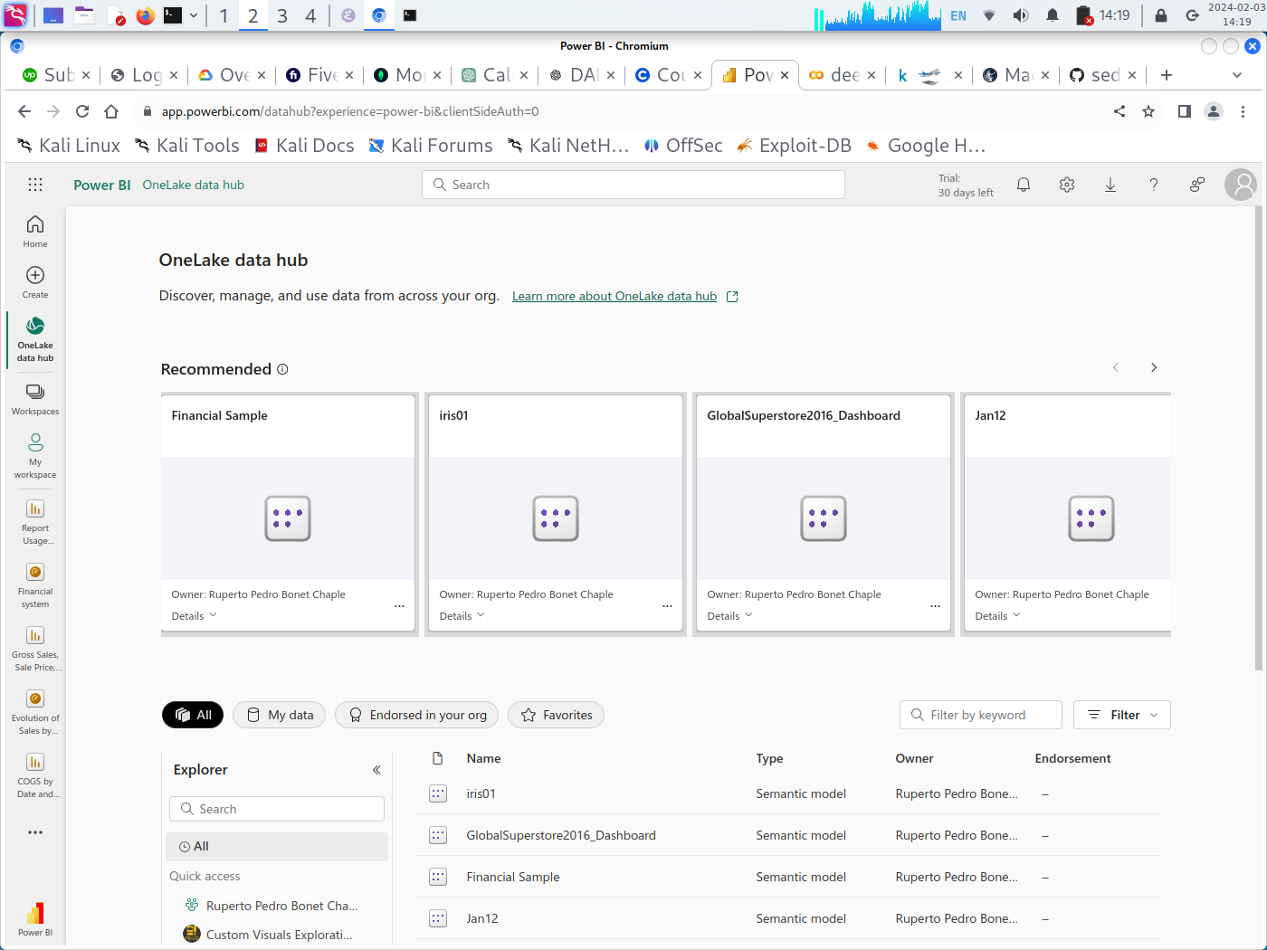
ONE LAKE DATA HUB

Slide 16
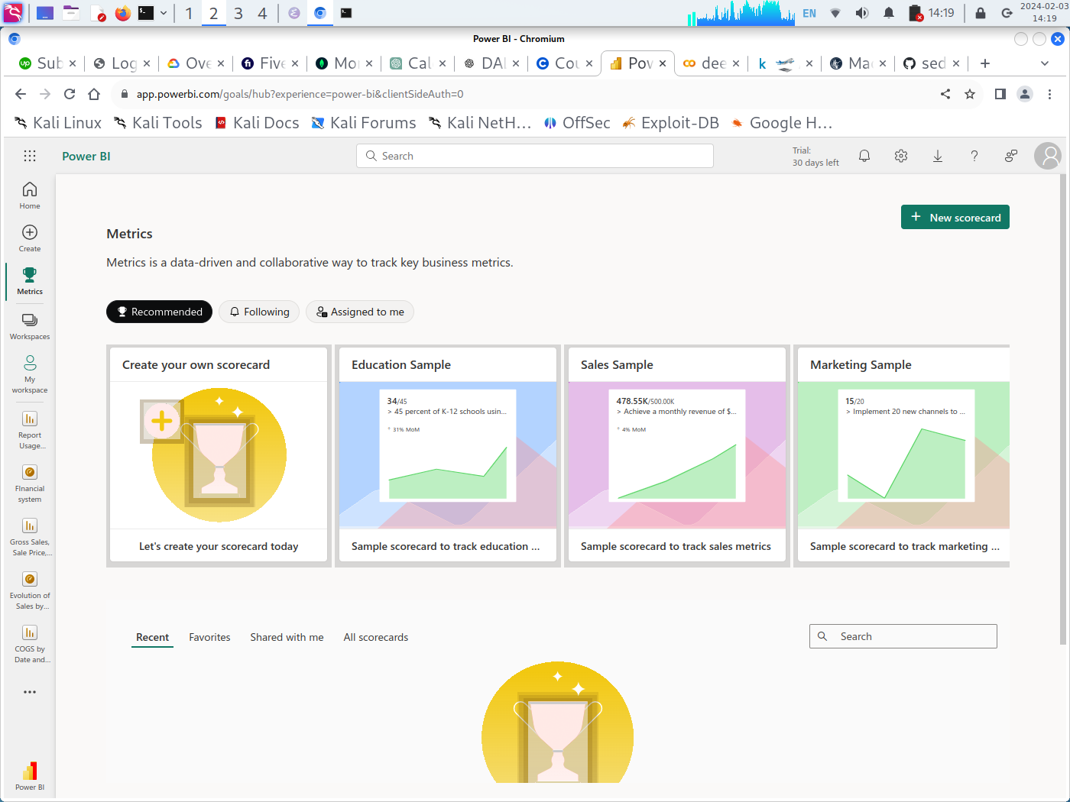
METRICS

Slide 17
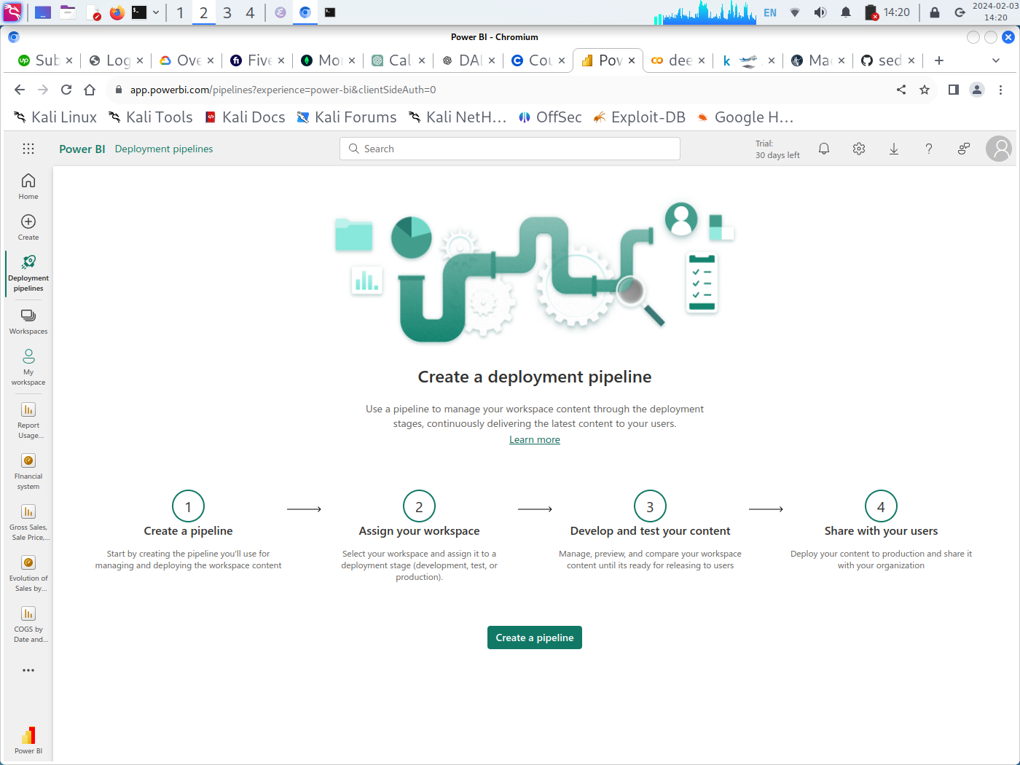
DEPLOYMENT PIPELINE

Slide 18
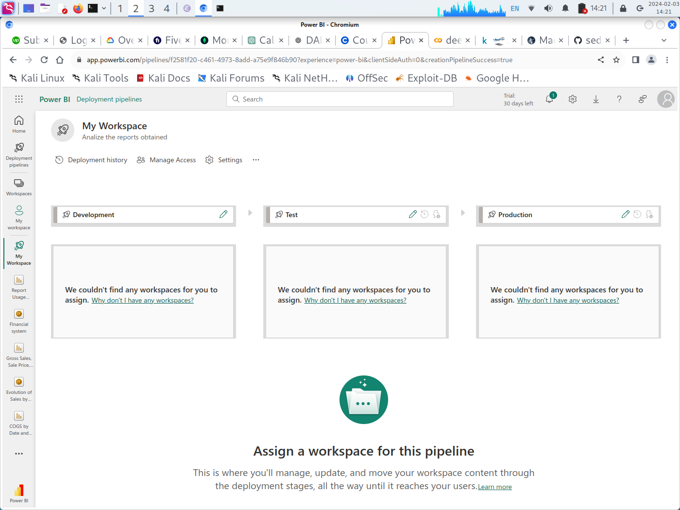
DEPLOYMENT PIPELINE IN MY WORKSPACE

Slide 19
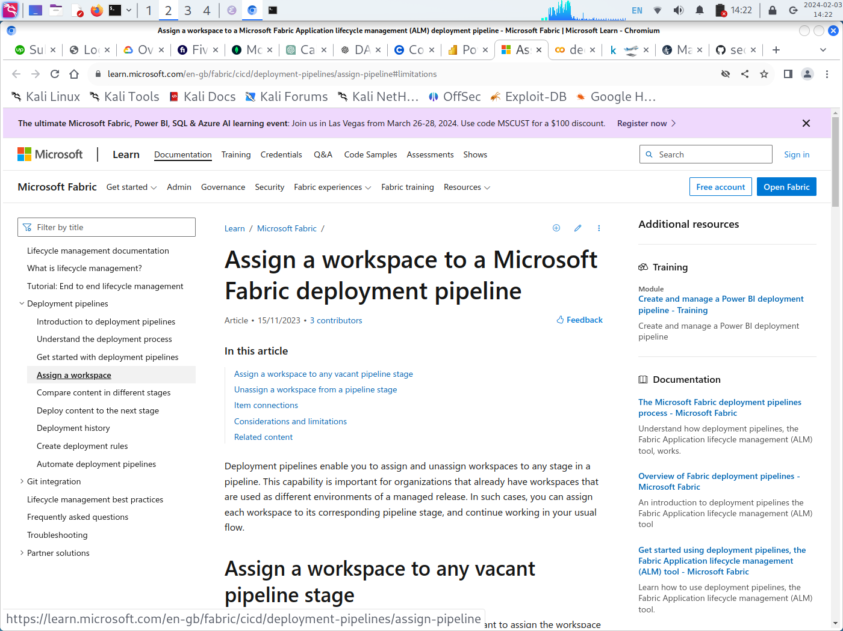
ASSIGN A WORKSPACE TO A DEPLOYMENT PIPELINE

Slide 20
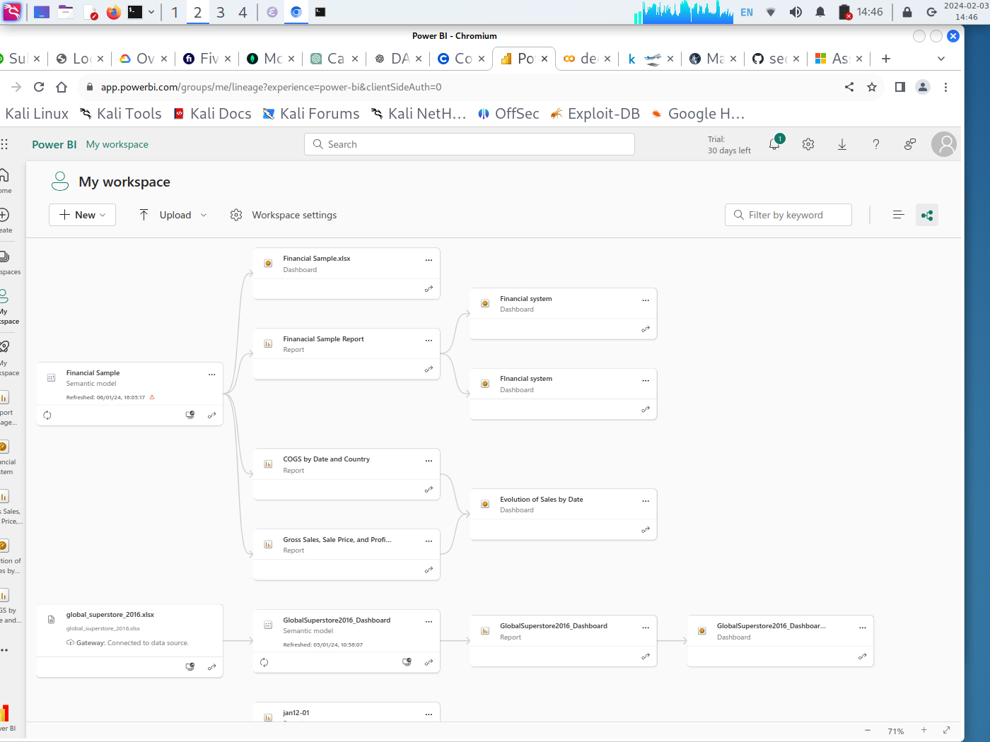
LINEAGE OF MY WORKSPACE

Slide 21
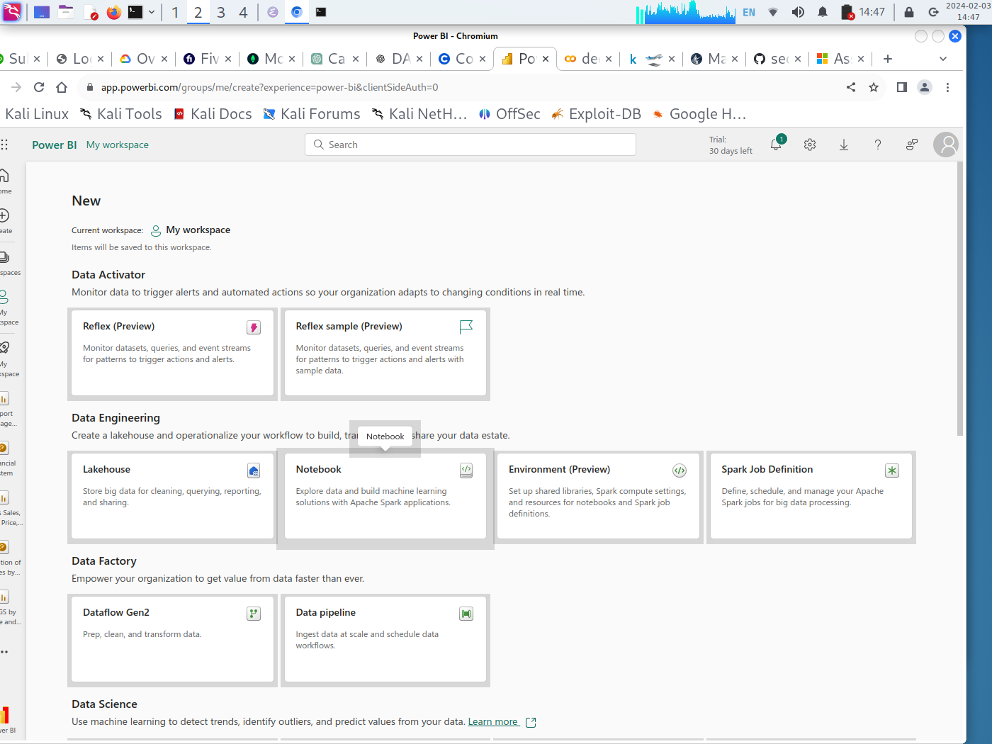
DATA FEATURES IN POWERBI

Slide 22
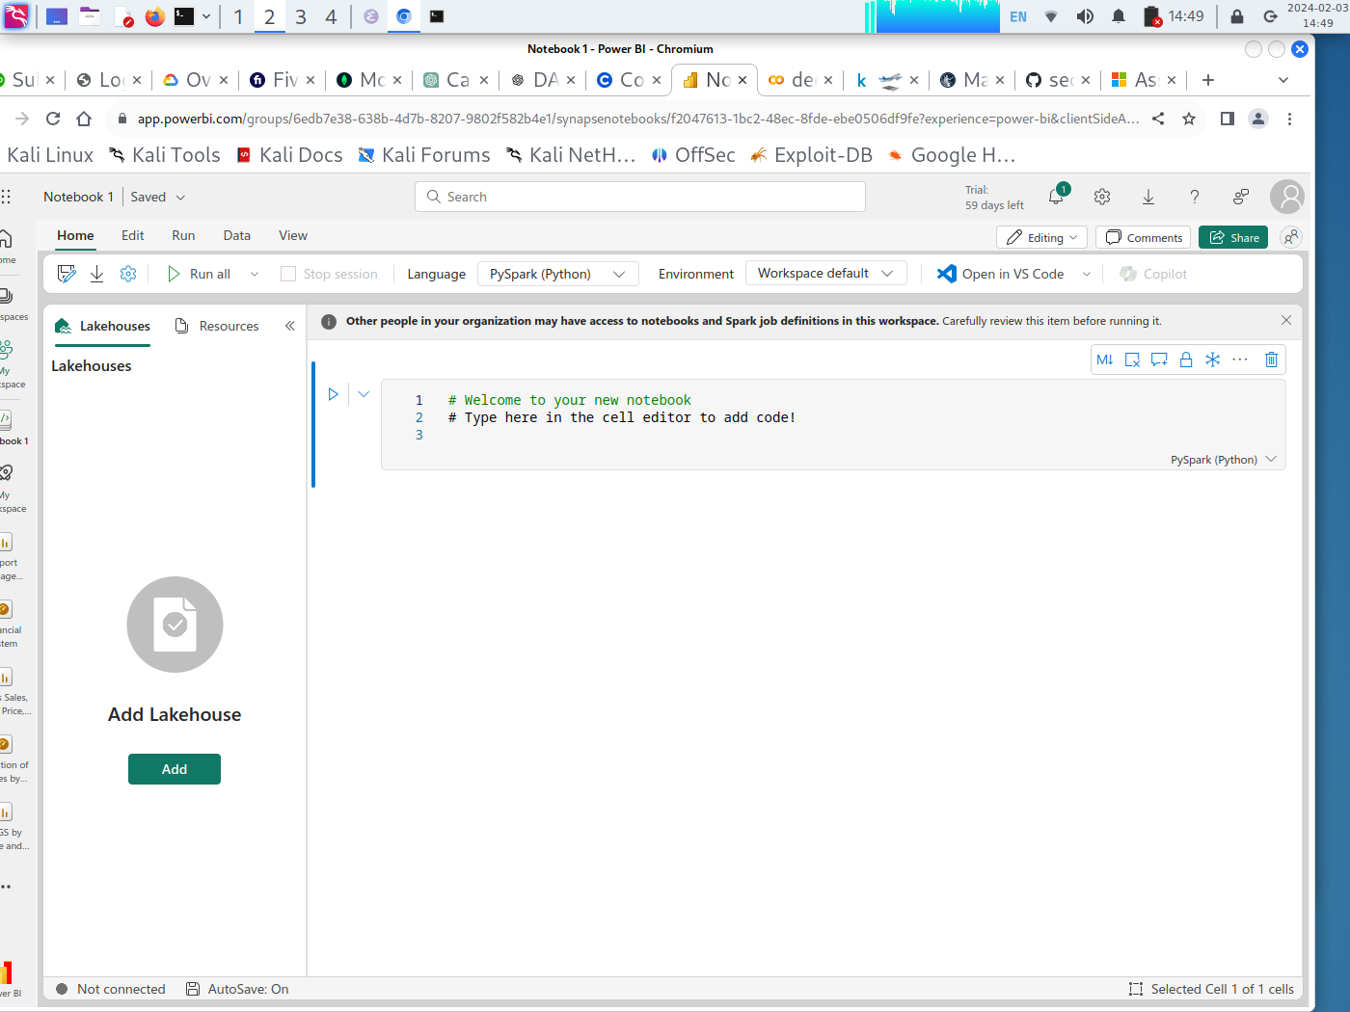
ADD LAKEHOUSE AND QUERIES IN POWERBI

Slide 23
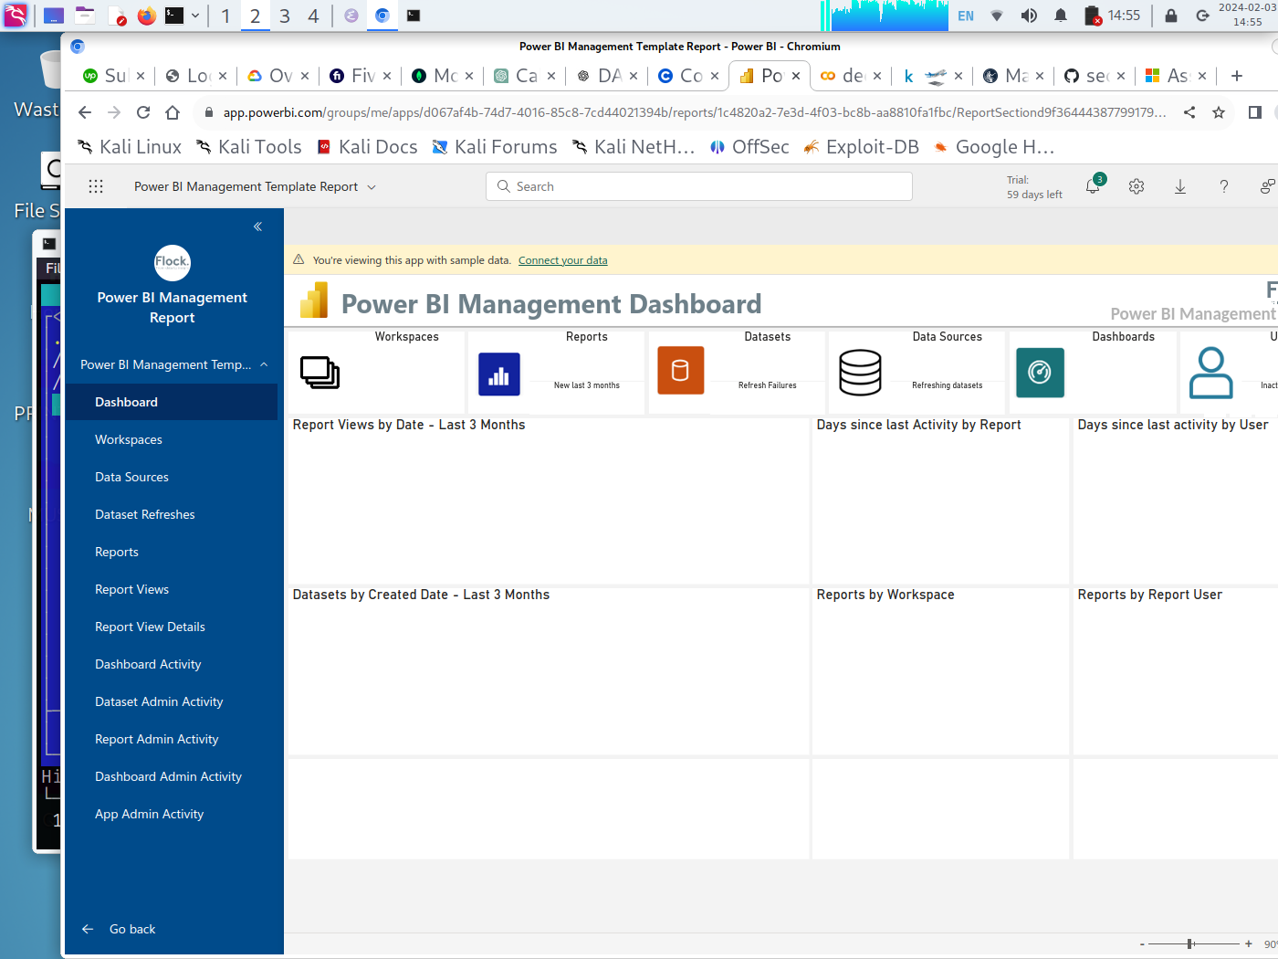
POWER BI MANAGEMENT DASHBOARD

Slide 24
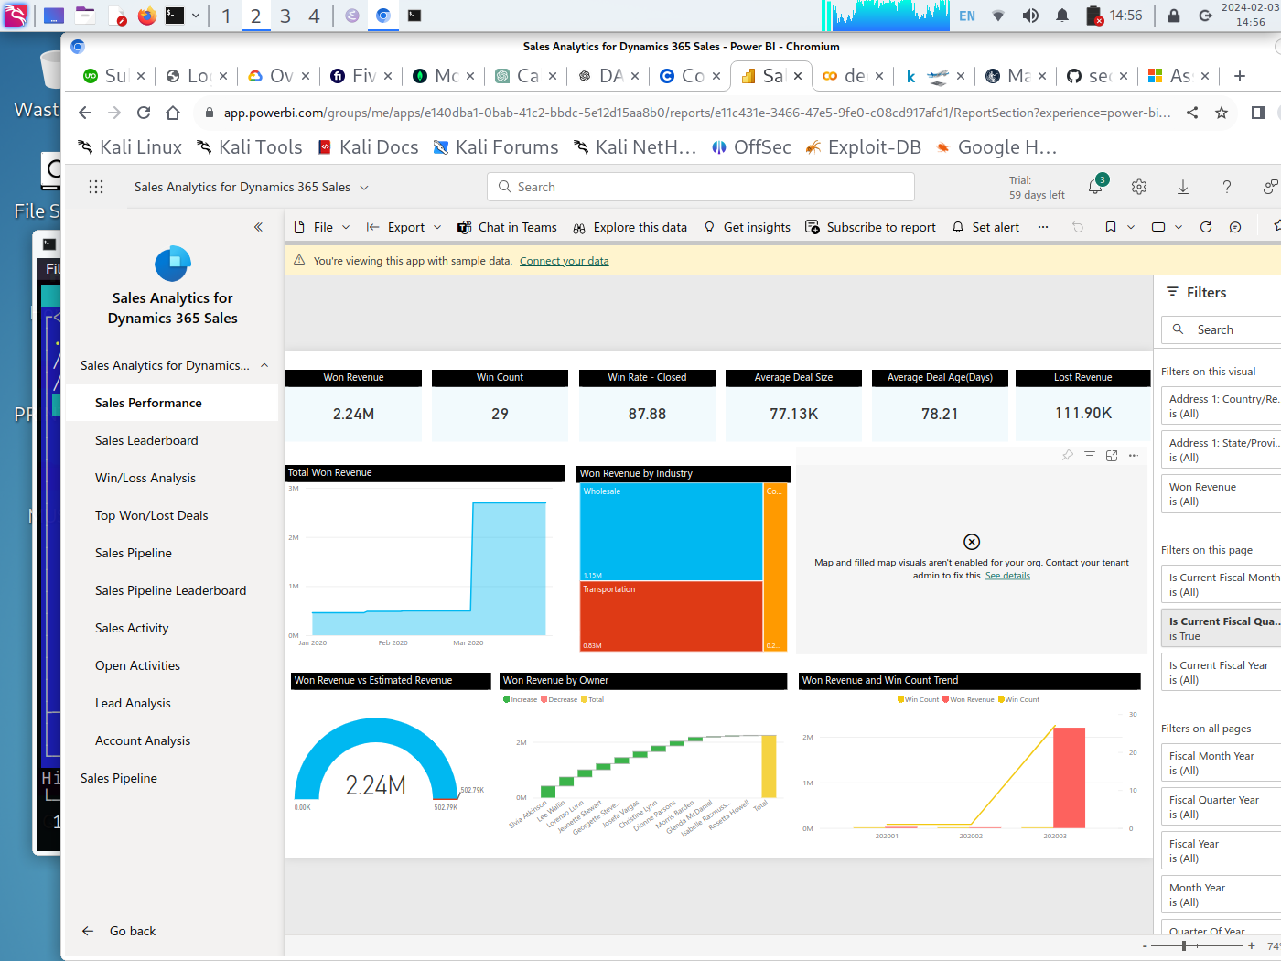
SALES ANALYTICS FOR DYNAMICS 365 SALES

Slide 25
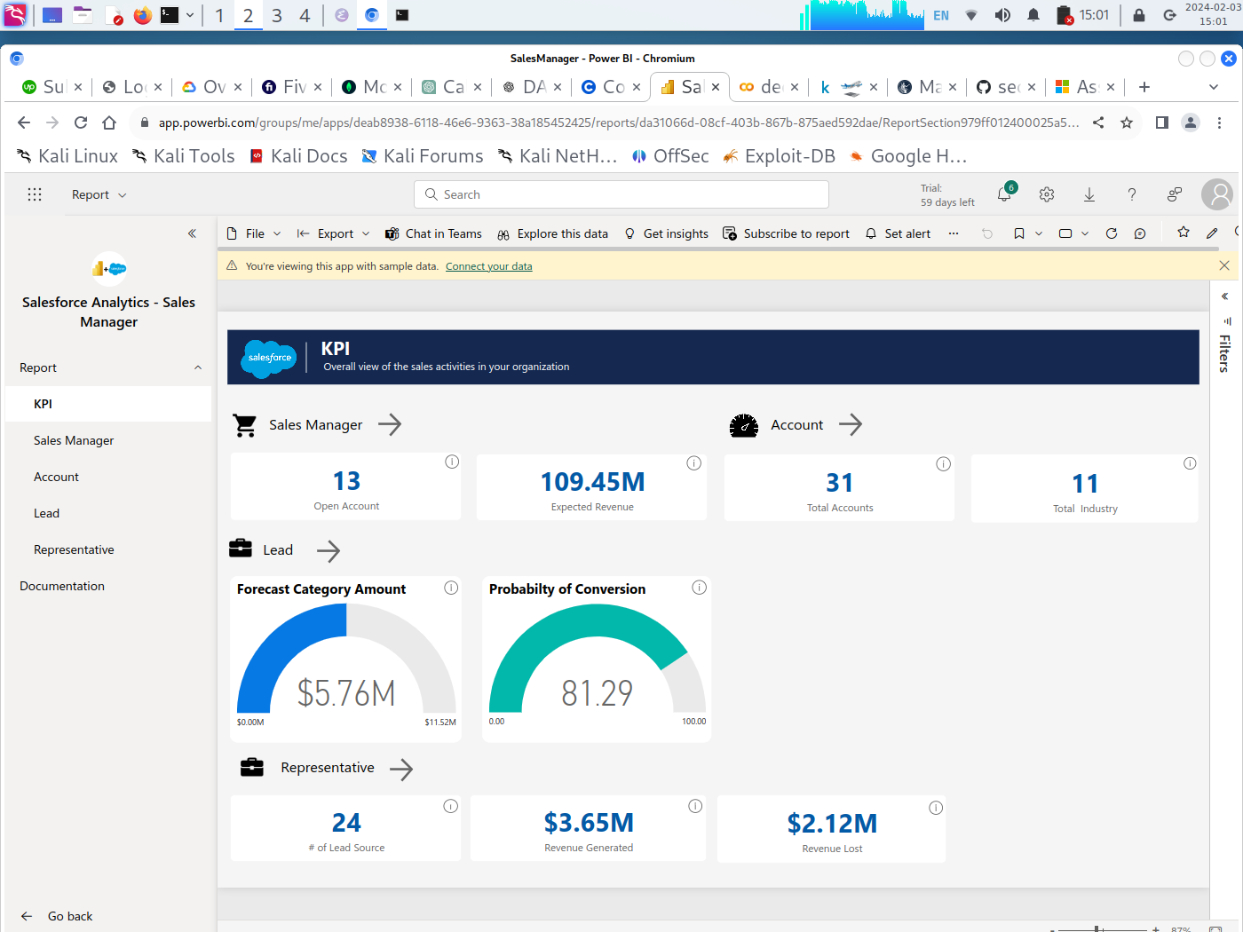
SALESFORCE ANALYTICS

Slide 26
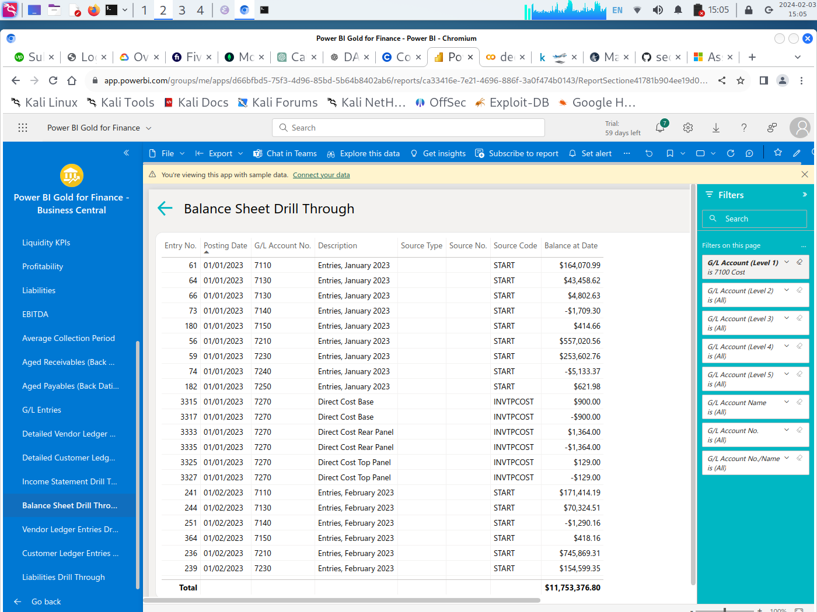
POWER BI GOLD FOR FINANCE

Slide 27
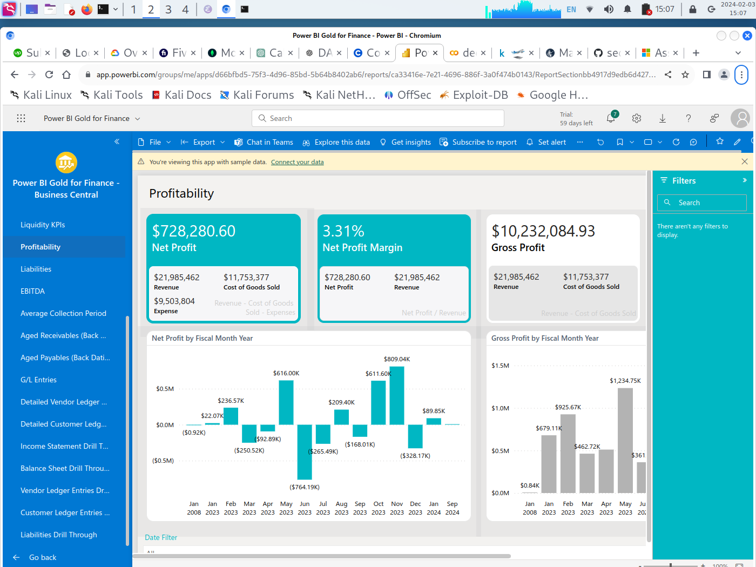
POWER BI GOLD FOR FINANCE

Slide 28
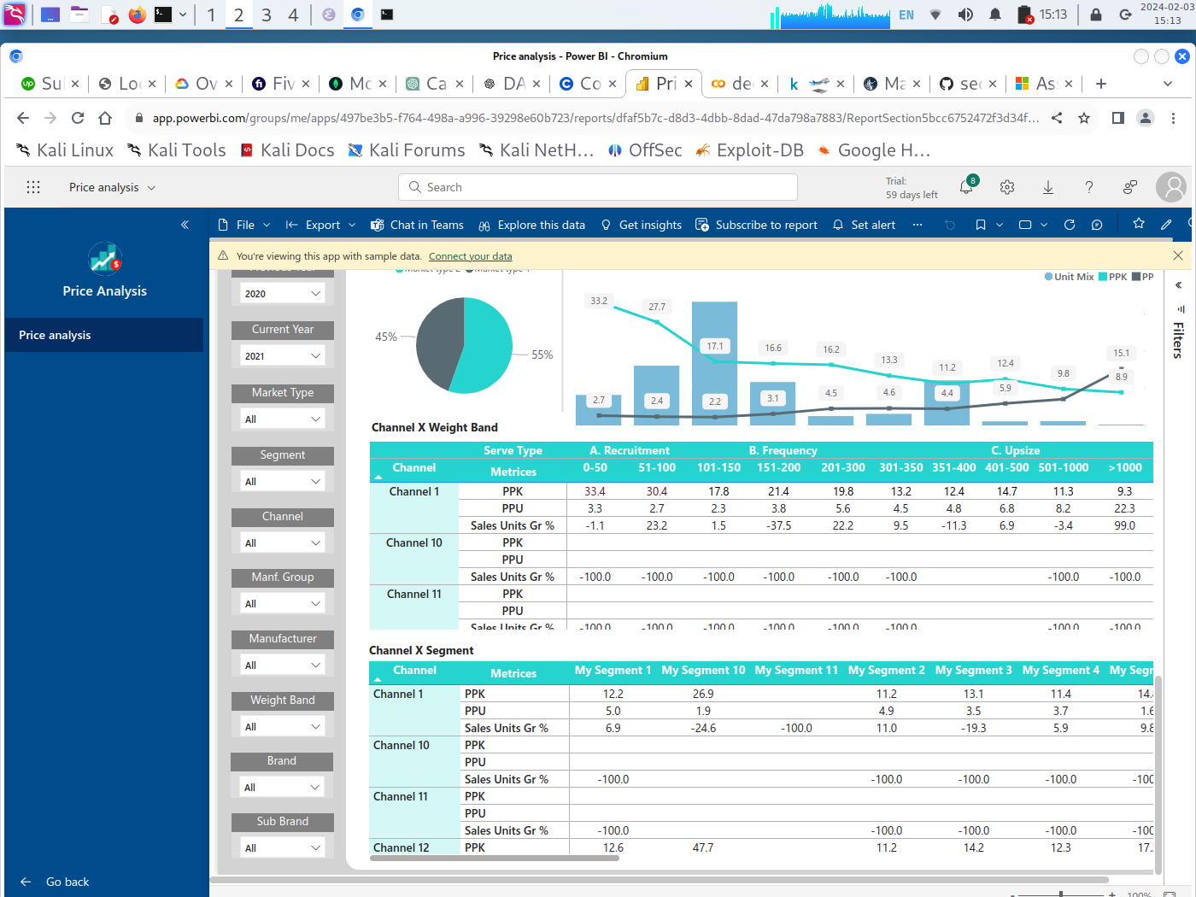
PRICE ANALYSIS

Slide 29
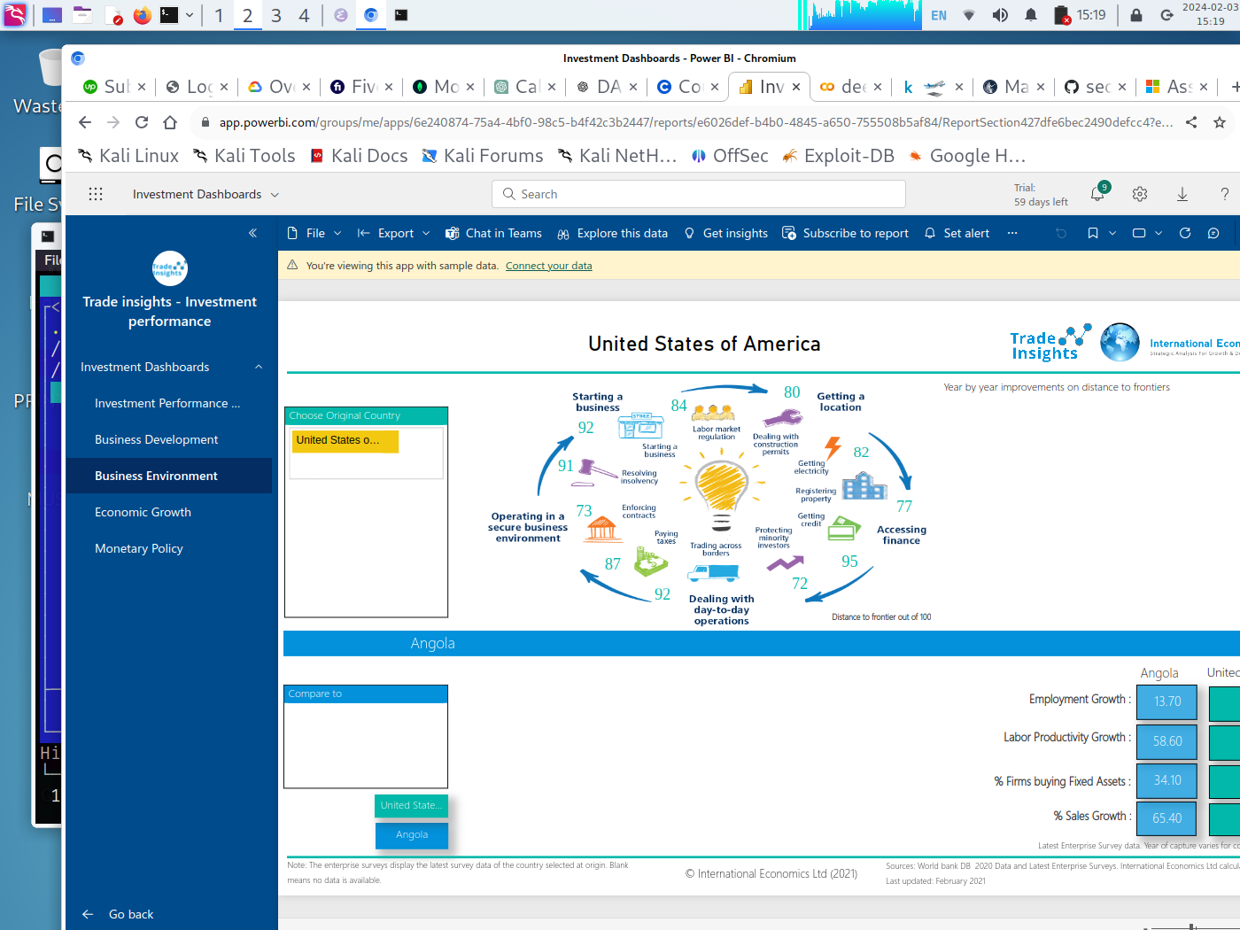
TRADE INSIGHTS

Slide 30
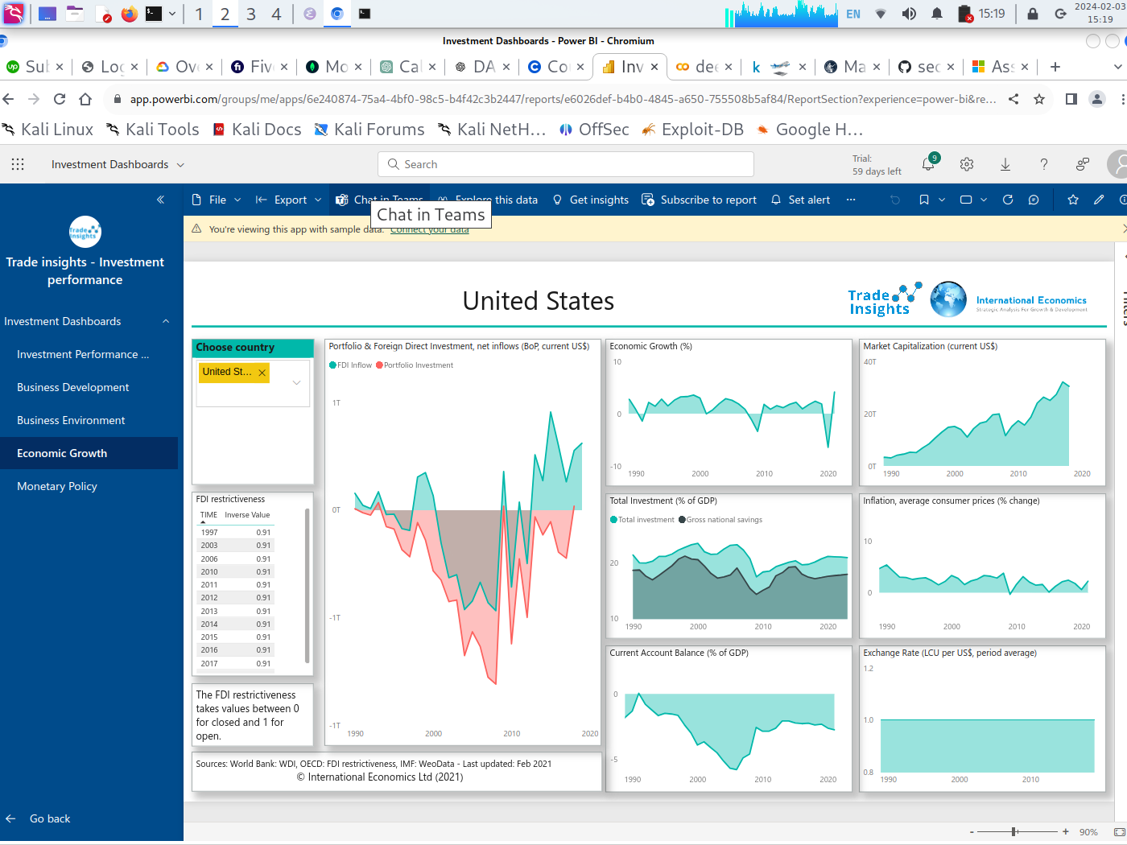
TRADE INSIGHTS

Slide 31
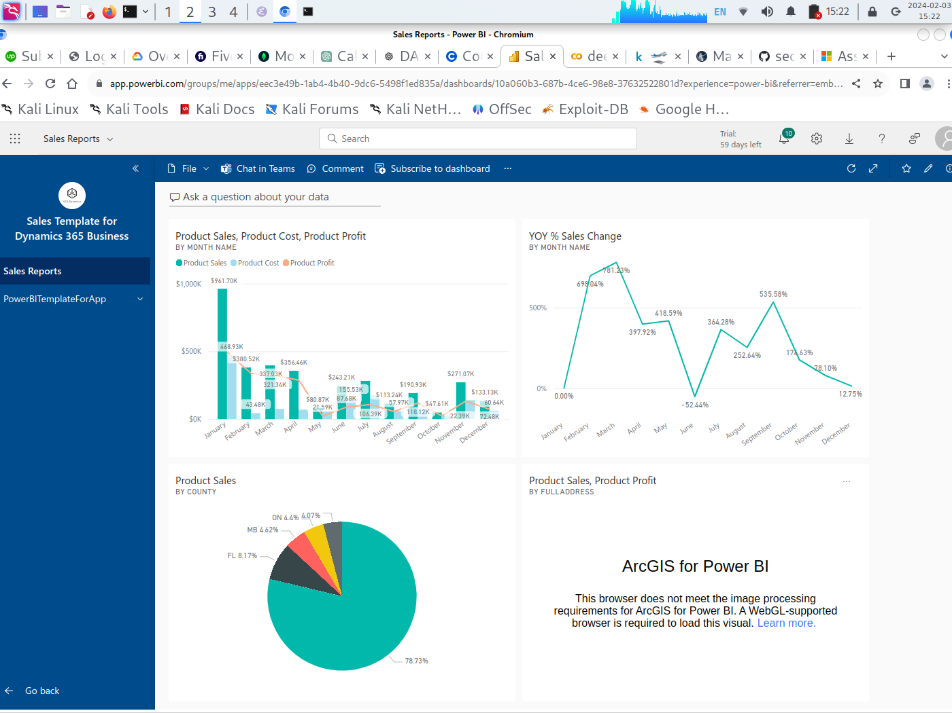
ARGIS FOR POWERBI

Slide 32
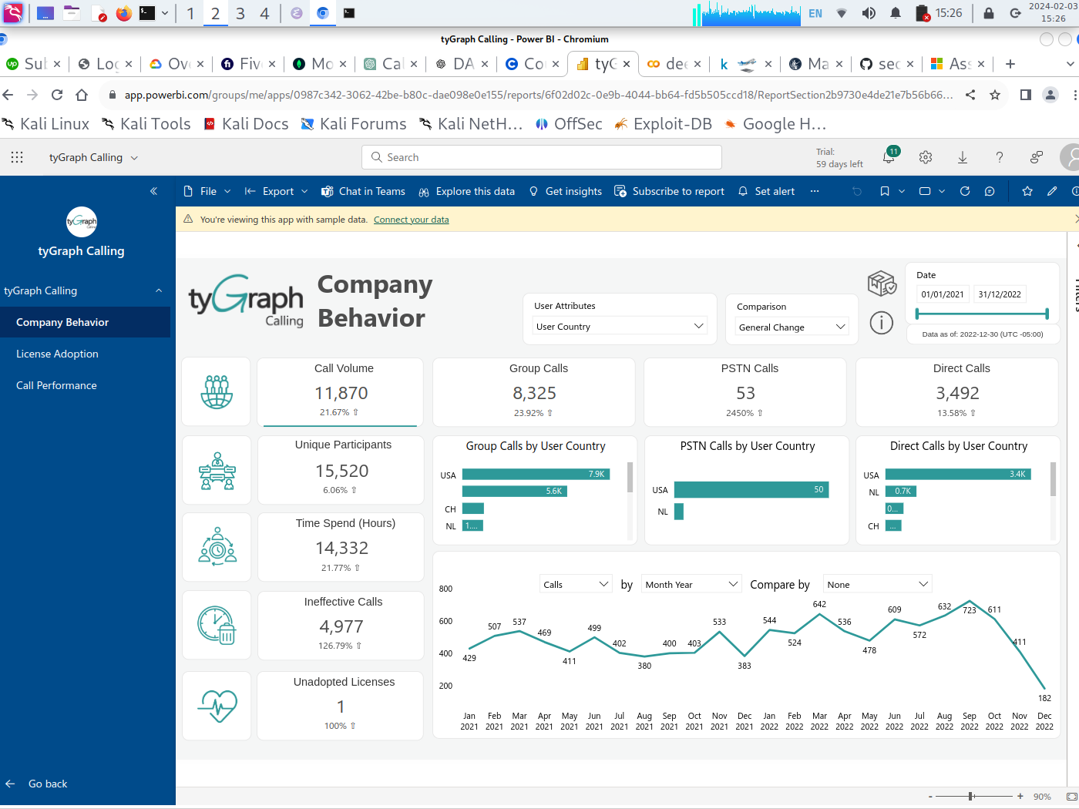
TyGraph app

